Slide 1

Holidays and Travelling

Slide 2
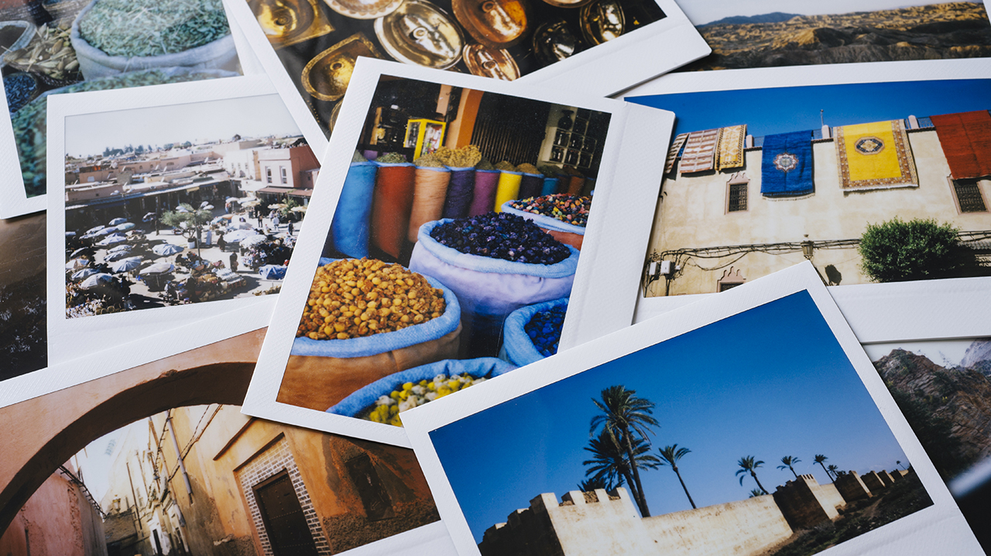
In my country and abroad
In my country:
Research and Planning
Travel Documents
Health Preparations
Finances
Packing
Security
Abroad:
Language
Cultural Etiquette
Technology
Transportation
Safety

Slide 3
i
In my country and abroad
In my country:
Research and Planning
Travel Documents
Health Preparations
Finances
Packing
Security
Abroad:
Language
Cultural Etiquette
Technology
Transportation
Safety

Slide 4
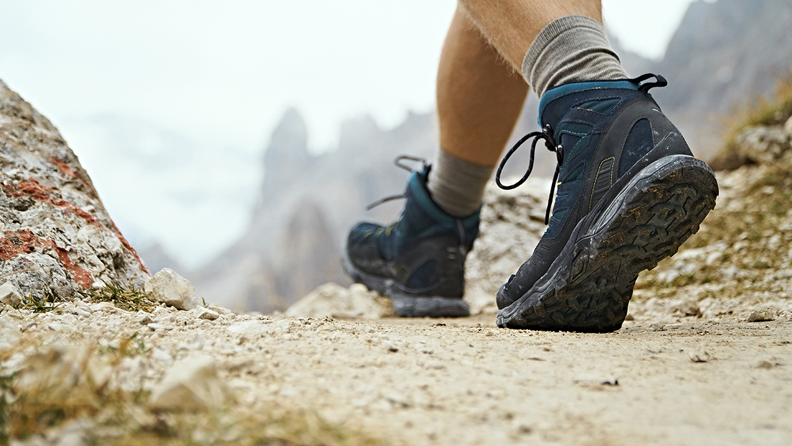
Advantages:
Freedom and Flexibility
Decision-Making Control
Budget Control
Disadvantages:
Loneliness
Safety Concerns
Costs

Slide 5
Advantages:
Freedom and Flexibility
Decision-Making Control
Budget Control
Disadvantages:
Loneliness
Safety Concerns
Costs

Slide 6

Advantages:
Safety in Numbers
Cost Savings
Logistical Ease
Disadvantages:
Potential for Conflict
Waiting and Coordination
Less Cultural Immersion

Slide 7
Advantages:
Safety in Numbers
Cost Savings
Logistical Ease
Disadvantages:
Potential for Conflict
Waiting and Coordination
Less Cultural Immersion

Slide 8
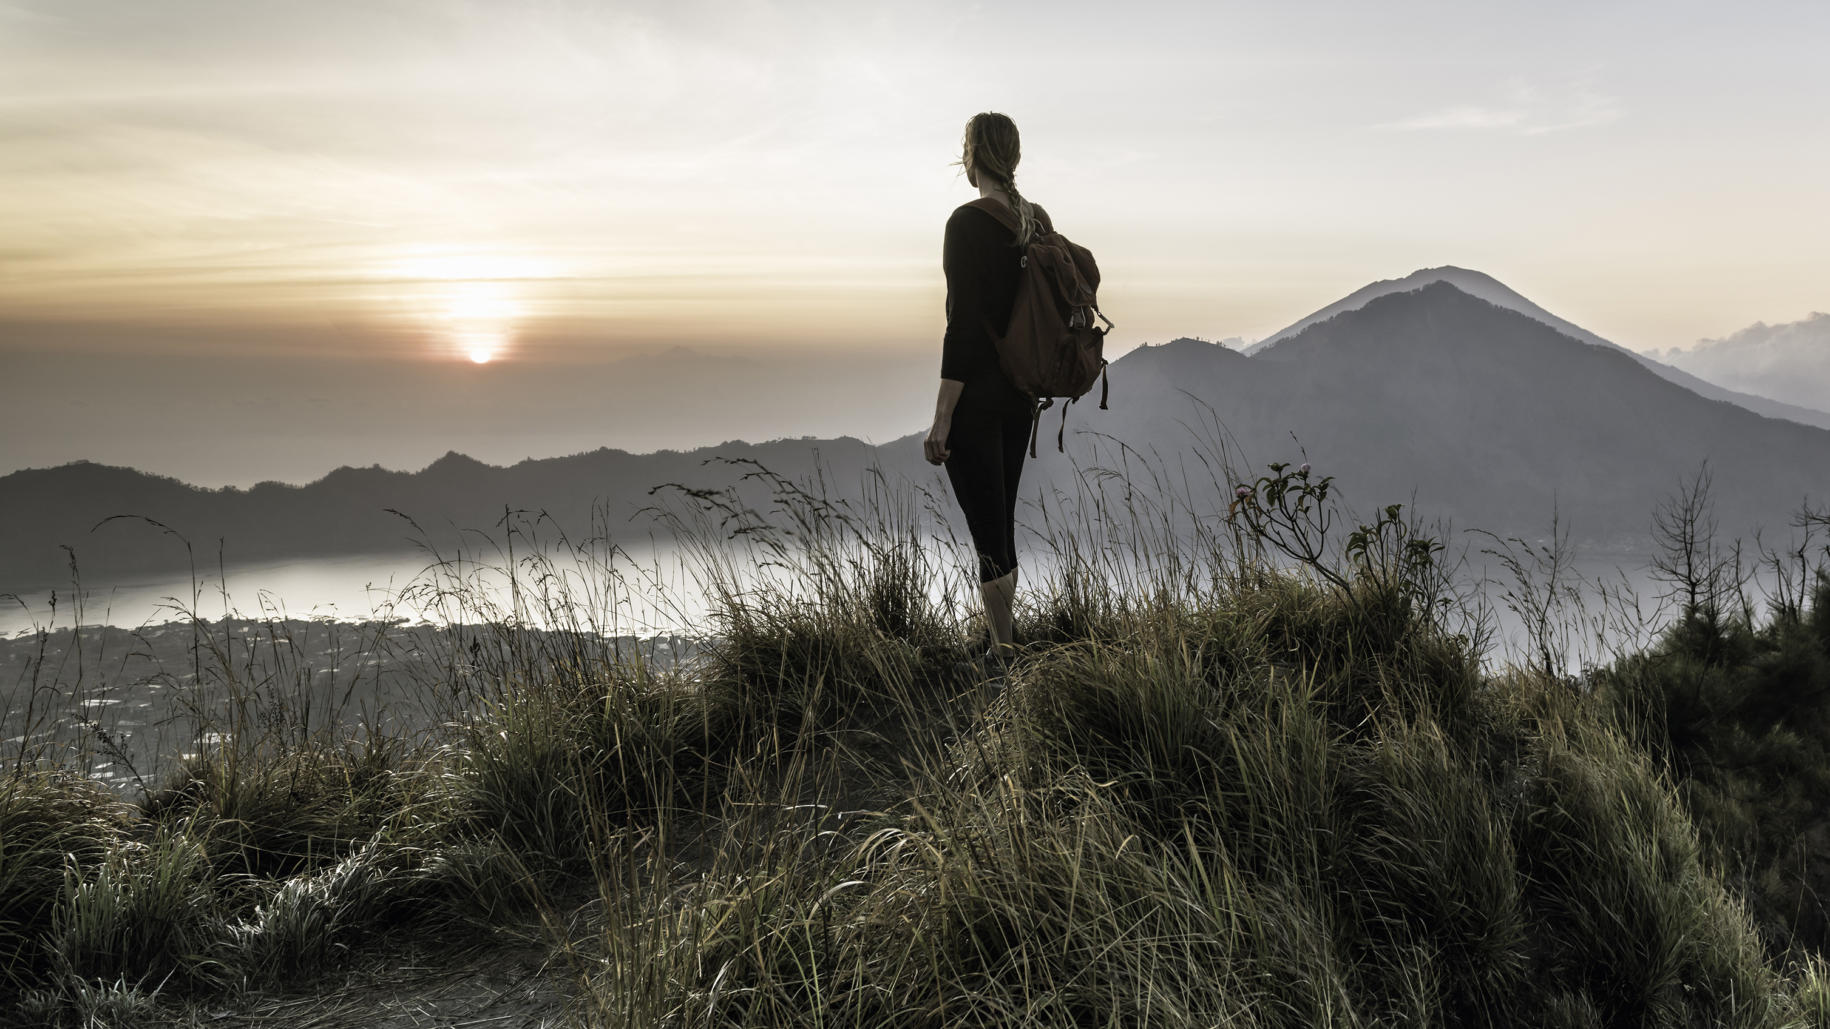
Advantages:
Familiarity
Cost Savings
Support Local Economy
Disadvantages:
Potential for Routine
Less Adventure
Weather Constraints

Slide 9
Advantages:
Familiarity
Cost Savings
Support Local Economy
Disadvantages:
Potential for Routine
Less Adventure
Weather Constraints

Slide 10
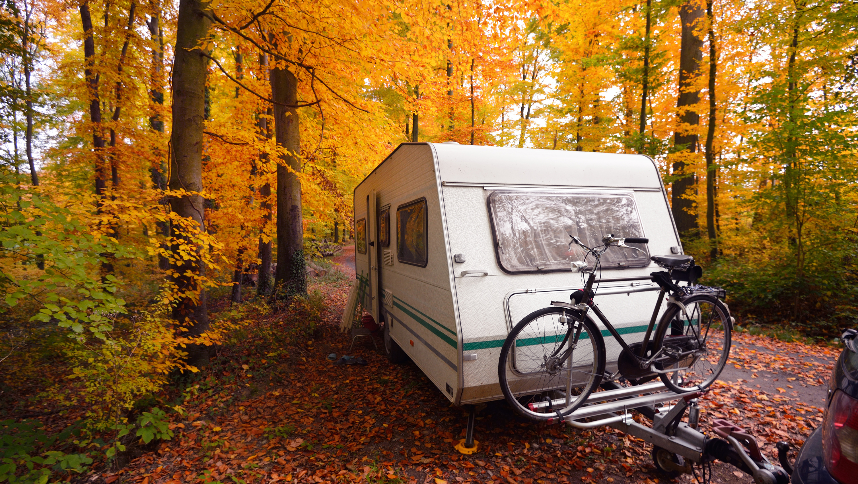
Advantages:
Cultural Exposure
Adventure and Novelty
international Cuisine
Disadvantages:
Costs
Language Barriers
Safety Concerns

Slide 11
Advantages:
Cultural Exposure
Adventure and Novelty
international Cuisine
Disadvantages:
Costs
Language Barriers
Safety Concerns

Slide 12

thanks for your attentions

